Slide 1



Clinical Nutrition and Human Rights
An International Position

Slide 2





International Working Group for Patients´ Right to Nutritional Care
Dr Cristina Cuerda
Pr Rocco Barazzoni
Pr Stéphane Schneider
Unaffiliated Experts:
Pediatrics
Pr André Briend
Pr Régis Hankard
Human Rights
Pr Isabelle Hannequart
History
Pr Loic Bienassis
Dr Juan B Ochoa
Pr Gil Hardy
Dr Albert Barrocas
Pr Isabel Correia
Pr Karin Papapietro
Dr Charles Bermudez
Dr Winai Ungpinitpong
Dr Teresa Pounds
Dr Katerina Zakka
WG Coordinator Dr. Diana Cárdenas

Slide 3
Clinical Nutrition and Human Rights
The Human Rights Based Approach (HRBA) is a new topic in Clinical Nutrition
HRBA involves interdisciplinary collaboration between:
  Medicine
  Human & Social Sciences
  Biological Sciences
  Pharmaceutical Sciences
  Nutrition and Dietetics
HRBA is one of several strategies to raise awareness of the need for universal access to nutritional care

Slide 4
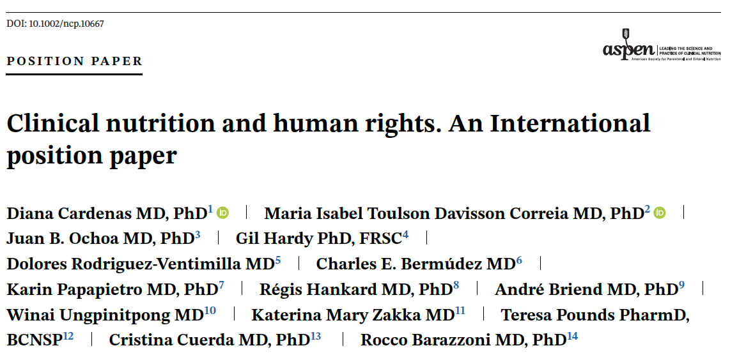
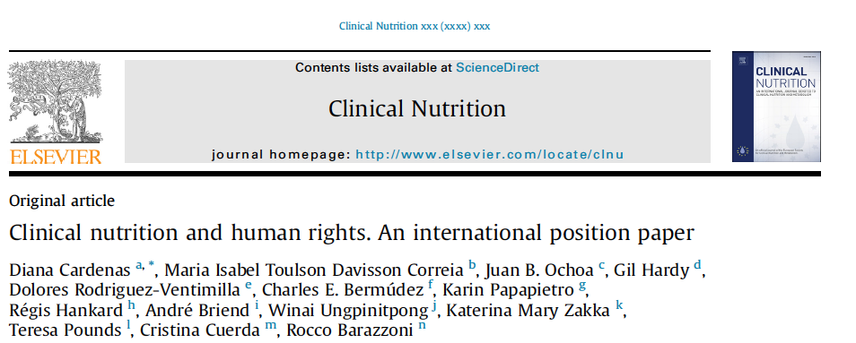
An International Position Paper
Cardenas D, Correia MITD, Ochoa JB, Hardy G, et al. Clinical nutrition and human rights. An international position paper. Clin Nutr. 2021 Jun;40(6):4029-4036. doi: 10.1016/j.clnu.2021.02.039.
Cardenas D, Correia MITD, Ochoa JB, Hardy G, et al. Clinical Nutrition and Human Rights. An International Position Paper. Nutr Clin Pract. 2021 Jun;36(3):534-544. doi: 10.1002/ncp.10667.

Slide 5
Clinical Nutrition and Human Rights
Aims and Objectives
The aim of this first position paper is to provide the link between clinical nutrition and human rights.
Our objectives are:
  To characterize nutritional care as a human right
  To highlight the need for early diagnosis and treatment of DRM*
  To advocate nutritional care as part of a holistic process of patient care
*DRM = disease-related malnutrition

Slide 6
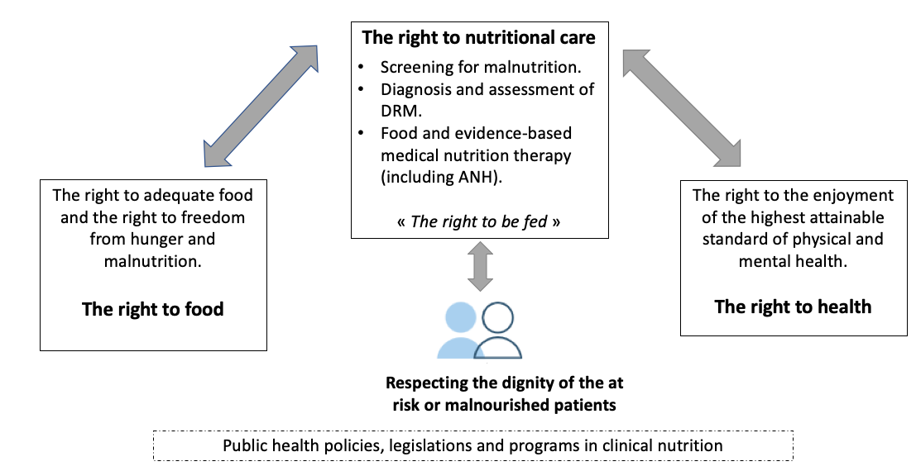
Nutritional Care is at the intersection of the Right to Food and the Right to Health
DRM: Disease-related malnutrition; AANH: Artificially administered Nutrition and Hydration.

Slide 7

Clinical Nutrition and Human Rights
The human right to nutritional care can be defined by:
The scope
The foundation
The duty-bearers

Slide 8
Clinical Nutrition and Human Rights
THE SCOPE
We are advocating that all patients have the right to benefit from the whole process of nutritional care:
  The right to timely nutritional screening
  The right to DRM* diagnosis
  The right to nutritional assessment
  The right to appropriate evidence-based nutritional therapy
  The right to regular monitoring
  The right for therapy to be managed by an interdisciplinary team
  All governments have the duty to guarantee these rights
*DRM: Disease-related malnutrition

Slide 9
Clinical Nutrition and Human Rights
EVIDENCE-BASED NUTRITIONAL THERAPY
The patient has the right to receive:
A regular hospital diet
A therapeutic diet (i.e. food modification and supplements)
Artificially Administered Nutrition and Hydration
  Enteral Nutrition
  Oral Nutrition Supplements
  Parenteral Nutrition

Slide 10

Clinical Nutrition and Human Rights
We are NOT advocating:
The right to be free from malnutrition
The obligation to feed all patients at any stage of life and at any cost
On the contrary:
HRBA implies that ethically, the best decision for the patient must be taken
This may include, under certain circumstances, the decision not to feed

Slide 11
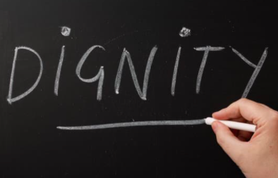
Clinical Nutrition and Human Rights
The Foundation for the Right to Nutritional Care is based on:
  Human Dignity
  Ethical Principles
Notes:
A human right can be defined in accordance to its foundation, its duty-bearers and its content or scope.

Slide 12

Clinical Nutrition and Human Rights
The Duty Bearers
  The State and policymakers
  Institutional managers
  Healthcare professionals and caregivers
  The human right to nutritional care must be the goal of state policies and programs regardless of economic, social, cultural, religious or political backgrounds

Slide 13
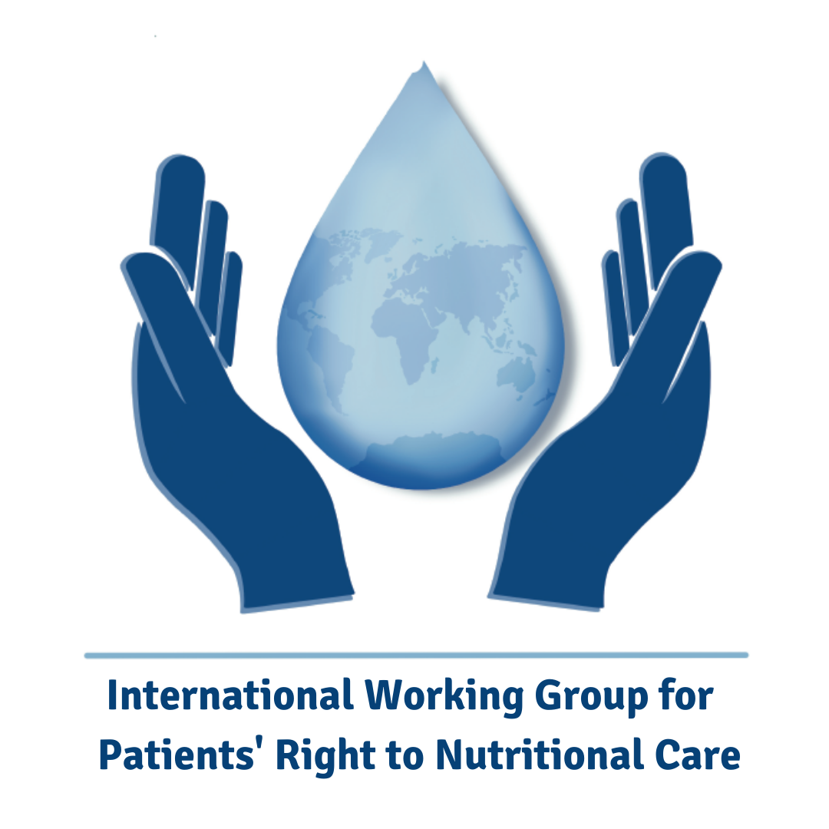
How can the human rights based approach benefit clinical nutrition and patient care?

Slide 14
All patients have the right to benefit from the whole process of nutritional care (i.e. right to be screened and diagnosed for DRM**)
HRBA*
4 Pillars
Clinicians
Societies
Policymakers
Patients
Clinical Nutrition practitioners have a duty to assure optimal and timely nutritional care with respect for the dignity of those in need of nutrition care.
Professional Societies have a duty to promote nutritional care as a human right.
Governments are bound to respect, to protect and to fulfill the right to beneficiate of the whole process of nutritional care.
*HRBA: Human rights based approach ** DRM: disease-related malnutrition

Slide 15
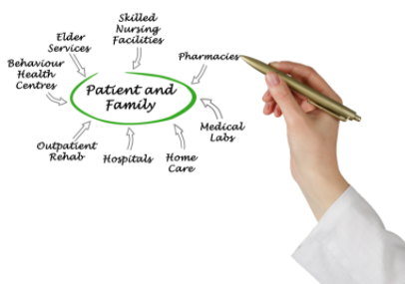
Potential impact of HRBA on Clinical Nutrition
Patients
Clinical Nutrition requires a patient-centered approach, where the needs and rights of the patient and their family/carer are of the greatest importance.

Slide 16

Potential impact of HRBA on Clinical Nutrition
Clinicians
Ethics and human rights must be guiding values for clinical nutrition practitioners
Human rights norms, ethical values and principles can contribute to moving forward in fighting DRM

Slide 17

Potential impact of HRBA on Clinical Nutrition
Clinical Nutrition Societies
HRBA* provides unique and valuable guidance for future Aims and Objectives of Clinical Nutrition Societies
*HRBA: Human rights based apprach

Slide 18


Potential impact of HRBA on Clinical Nutrition
Policymakers
HRBA* can help bridge the communication gaps between clinicians, scientists and policymakers.
HRBA* should form the basis for public health policies in Clinical Nutrition
*HRBA: Human rights based apprach

Slide 19

HRBA IMPLIES AN ETHICAL COMMITMENT
To recognize the vulnerability of the malnourished patient
To respect the dignity of the patient
HRBA IDENTIFIES SPECIFIC DUTIES FOR THE 4 PILLARS OF CLINICAL NUTRITION
HUMAN RIGHTS
BASED
APPROACH
Patients
Clinicians
Societies
Policyholders
HRBA IDENTIFIES MAJOR PRIORITIES AND OBJECTIVES FOR CLINICAL NUTRITION
Improve nutrition research and medical education
Highlight the economic aspects of nutritional care
Create an institutional culture that values nutritional care
Promote patient empowerment
Actions Required
THE HRBA TO NUTRITIONAL CARE REQUIRES ATTENTION TO 10 PRINCIPLES

Slide 20
Ten Recommended Principles for HRBA
Public Health Policy must make fulfilment of the right to nutritional care a fundamental axis in the fight against DRM
Clinical nutrition must be integrated into public health policy based on human rights, equity and economic values
Clinical nutrition education and research is a fundamental axis of the respect and the fulfilment of the right to nutritional care

Slide 21
Ten Recommended Principles for HRBA
4. Ethical principles and values in clinical nutrition including justice and equity in nutritional care access is the basis for the right to nutritional care
5. Clinicians, researchers and policy makers should work together to translate evidence-based medical nutrition therapy into policy
6. To be effectively implemented, public health policy on clinical nutrition should consider all patients at nutritional risk, including childbearing women and children, as the target population

Slide 22
Ten Recommended Principles For HRBA (Continued)
7. Public health policy should consider nutritional care as part of the holistic approach for the patient, which aims to prevent and treat DRM and improve clinical outcomes
8. Nutritional care requires an institutional culture that follows ethical principles and values, and an interdisciplinary approach
9. All nutritional care must include an after-hospital discharge plan, involving patients and caregivers, and be subject to an annual audit
10. Patient empowerment is a key enabler to necessary action to optimise nutritional care

Slide 23
Clinical Nutrition and Human Rights
Key Messages
Nutritional care should be considered a fundamental human right intrinsically linked to the right to food as well as to the right to health
The patient has the right to:
  be screened and diagnosed for DRM
  receive regular hospital diet, therapeutic diet (food modification or supplements), medical nutrition therapy (AANH**) from an expert interdisciplinary team
The HRBA* to Clinical Nutrition could contribute globally to the construction of a moral, political and legal perspective to the concept of nutritional care
*HRBA: Human rights based apprach **AANH: Artificially administered Nutrition and Hydration

Slide 24
Clinical Nutrition and Human Rights
Key Messages
The HRBA* can be the cornerstone of the rationale of political and legal instruments in the field of clinical nutrition
From the legal and political point of view, HRBA* implies
  that states and duty-bearers are bound to certain obligations, whose effective implementation can legitimately be claimed by people
Duty bearers are bound “to respect, to protect and to fulfill” the patients’ right to benefit from the whole process of nutritional care
Governments have a duty to guarantee the right to nutritional care
*HRBA: Human rights based apprach

Slide 25
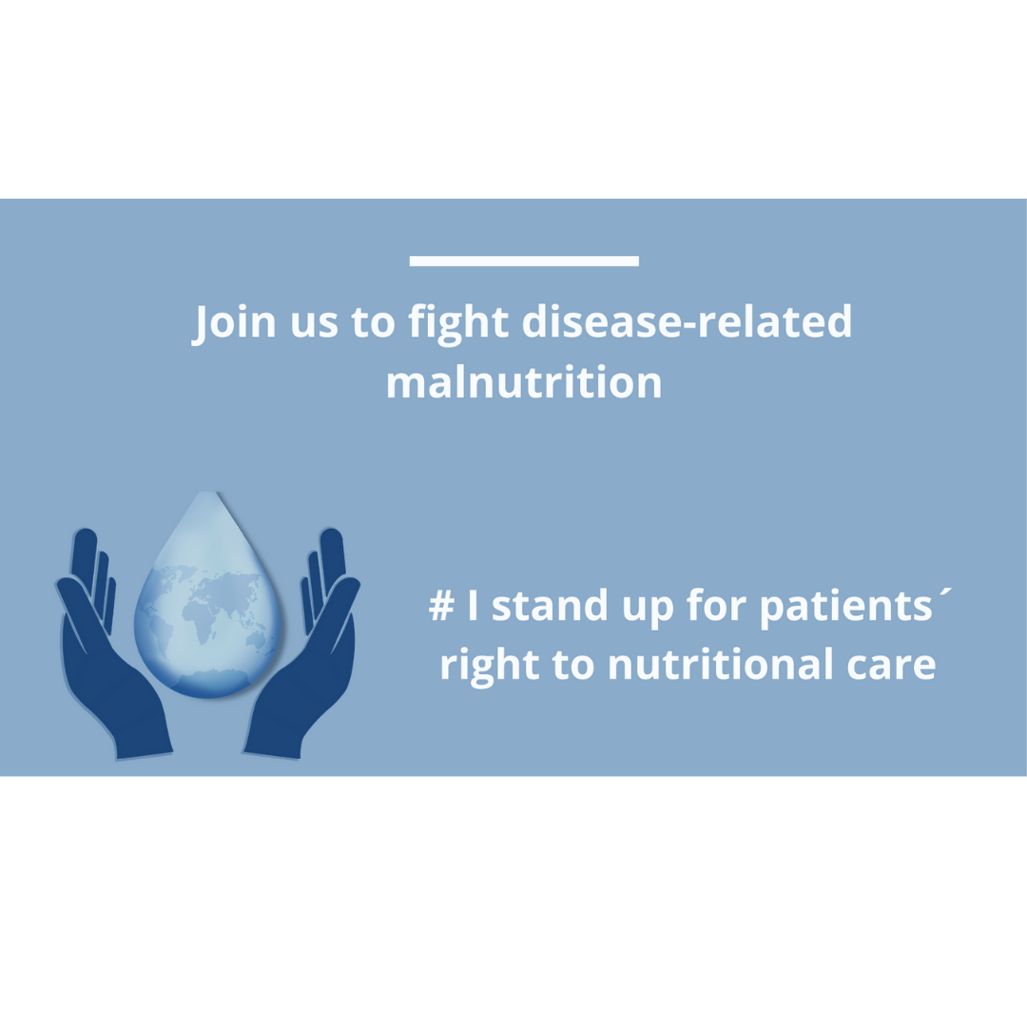

Slide 26

1. Dissemination of the position paper : NCP and CN “free access” https://authors.elsevier.com/a/1d5nSxUE3bV8%7E
2. Sharing the videos: youtube channel https://www.youtube.com/channel/UC9jizeJi-xh9Zc9BPuwqVpA

